Slide 1
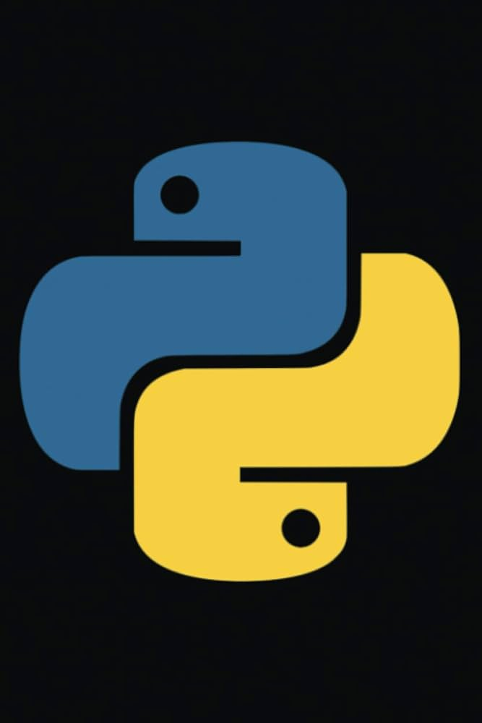
introduction & Python Basic Knowledge

Slide 2
introduction
Name :- Rohan khokhar
Study :- BCA IT
From :- Bhagwan Mahavir University
Contact :- 9016478938

Slide 3
Introduction to Python
Python :-
Python is a high-level, interpreted programming language known for its readability and versatility. Created by Guido van Rossum and first released in 1991, Python emphasizes code readability and simplicity, making it an excellent choice for both beginners and experienced developers.

Slide 4
Why learn python ?
Easy to read and write
Versatile: Web development, data science, automation, etc.
Large community and extensive libraries

Slide 5
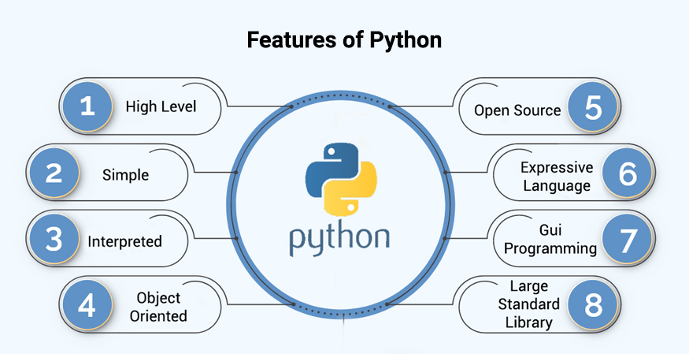
Features of Python
3.versatility

Slide 6
Basic Python Syntax
Python Syntax
Case-sensitive, indentation matters
Variables and Data Types
int, float, str, double
//syntax:-
datatype varible_name ;
Basic Operations (e.g., arithmetic operations and comparison opration)

Slide 7
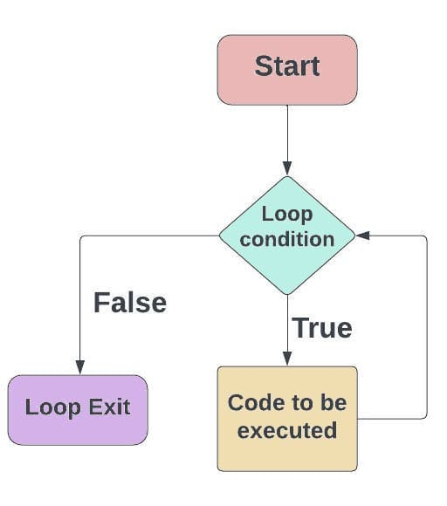
Python Control Structures
Conditional Statements (if, else if, else)
Loops (for, while)
Example Code Snippets :-

Slide 8
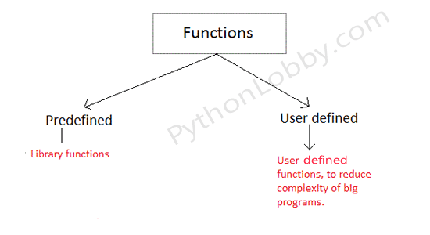
Functions in Python

Slide 9
Thank You

